Slide 1
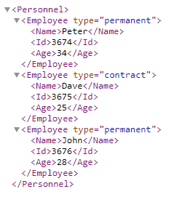
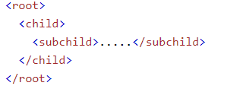
XML Syntax Rules
XML documents must contain one root element that is the parent of all other elements
In XML, it is illegal to omit the closing tag. All elements must have a closing tag
XML tags are case sensitive. The tag <Name> is different from the tag <name>.Opening and closing tags must be written with the same case
XML Attribute Values Must Always be Quoted

Slide 2
XML Syntax Rules
The XML prolog is optional. If it exists, it must come first in the document.
XML documents can contain international characters, like Norwegian øæå or French êèé.
To avoid errors, you should specify the encoding used, or save your XML files as UTF-8.
UTF-8 is the default character encoding for XML documents.
XML Prolog

Slide 3
XML Syntax Rules
Comments in XML

